Slide 1
Rakesh Rathore
Associate Professor of Physics
Government Degree College Chamba (H. P.)
Today --- dated 18/03/2024
Job and Study Opportunities after B.Sc. (Bachelor of Science)

Slide 2
Survey by Students Response
Interactions with students
Results of the Survey indicate that small number of students know about jobs in government sector.
Majority of the students told that they will go for B.Ed after B.Sc. / B.A.
Medical and Non Medical Stream of 10 + 2 system
18-03-2024
Part 1 --- common
Part 2----- specific for B.Sc.

Slide 3
Government Jobs
NEET and JEE Mains and advance
Medical ----- Doctor
and Non – Medical -- Engineer
18/03/2024
Government Services
Defence Services
Indian Railways

Slide 4
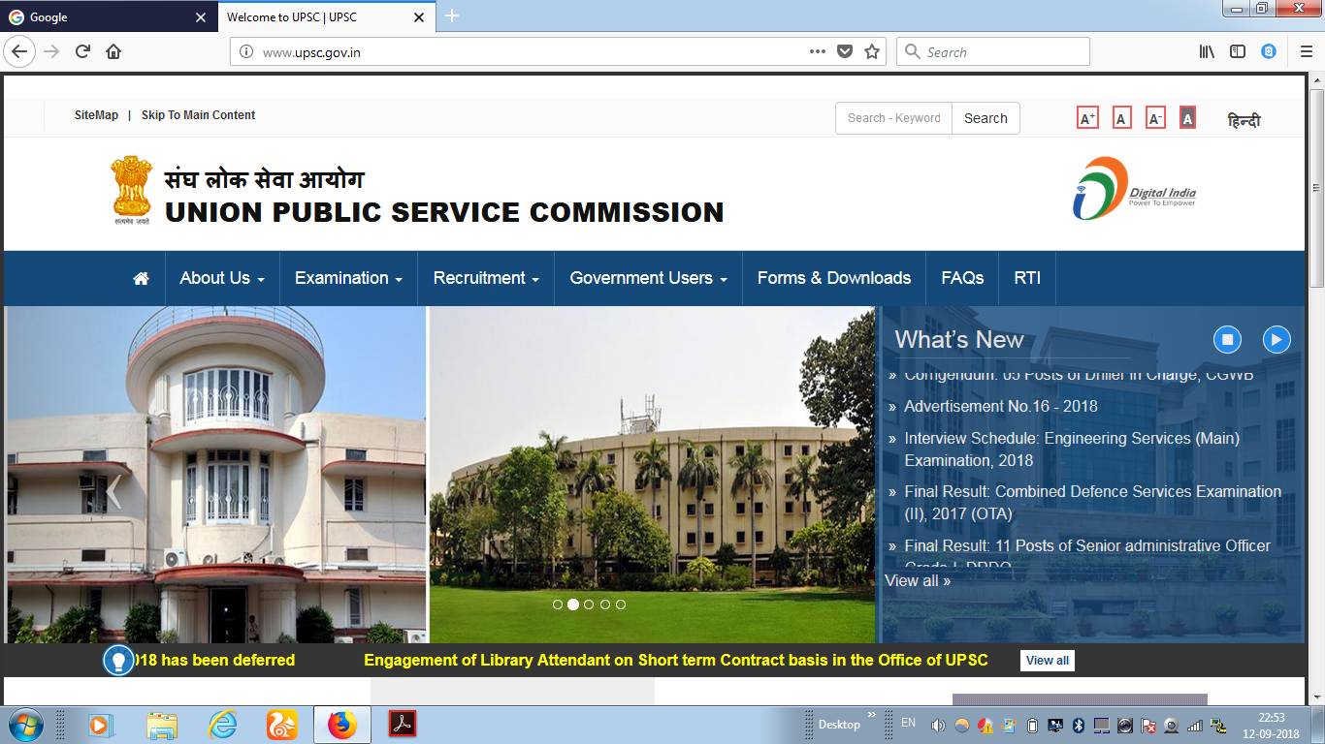
Notes:
Website address www.upsc.gov.in (Home page)

Slide 5
UNION PUBLIC SERVICE COMMISSION (UPSC)
Indian foreign Services – IFS
Indian Administrative Services – IAS
Indian Police Services - IPS
Indian Revenue Services – IRS
Group A and Group B Services in various Central and State Govt. Departments ( 26)
www.upsc.org
www.upsconline.nic.in

Slide 6
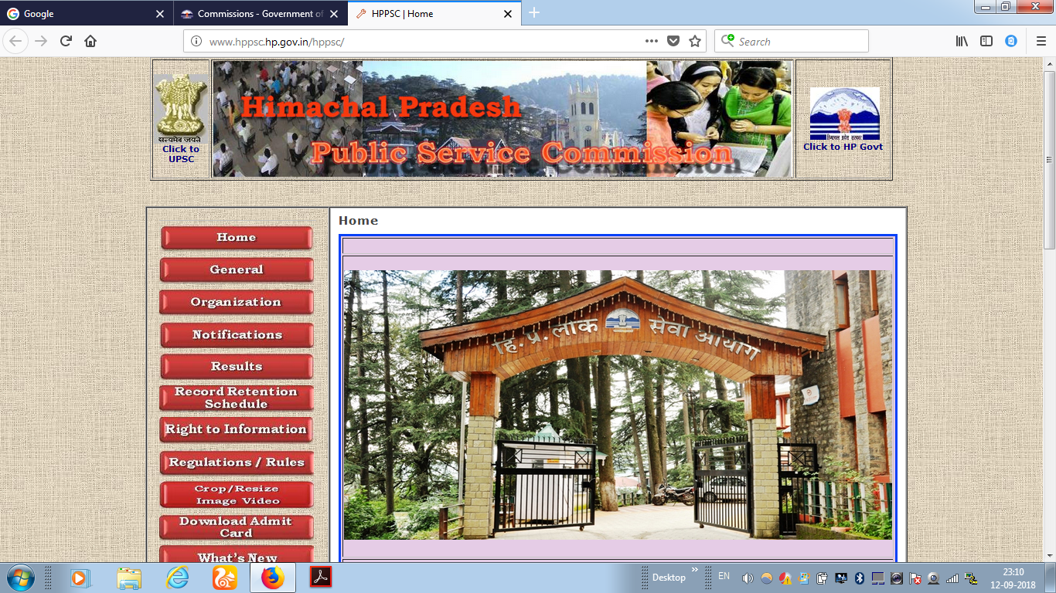
Notes:
At the state level we have www.hppsc.hp.gov.in (Home page)

Slide 7
HPPSC-http://www.hppsc.hp.gov.in www.hppsc.hp.gov.in
HAS Examination
SDM (Sub Division Magistrate )
Deputy Superintendent of Police (Dy. S. P.)
BDO / ETO
Tehshildar
Scientific Officer

Slide 8
Defence Ministry
www.careerairforce.nic.in
1. Combined Defence Services Examination (men’s only).
Two times in a year
B. Sc. Physics – 60% Marks, Age: 19-23 Years
2. Short Service Commission (Men and Women)
B. Sc. Physics- 60% Marks, Age: 19-23 Years
3. Ground Duty Branches (Men and Women)
a. Administration, b. Logistics, c. Accounts
B. Sc. Physics- 60% or M. Sc. Physics- 50% Marks, Age: 20-23 Yrs
d. Education e. Meteorology
M. Sc. Physics- 50% Marks, Age: 20-25 Years
4. Technician- B. Sc. Physics, 50% Marks, Age – below 45 Years,
Selection through written test,

Slide 9
Scientific Assistant
CSIR- 41Institutes www.csir.res.org
DST – 22 Institutes www.dst.gov.in
DRDO – 48 Institutes http://drdo.gov.in
Dept of Biotech – 11 Inst. http://dbtindia.nic.in
Agri- ICAR – 69 Institutes www.icar.org.in
Min. of Food processing Industries -23 Inst. http://mofpi.nic.in
Min. of Agro & Rural Industries – 11 Inst. http://msme.gov.in
Nuclear Technology – 07 Div
EL: B. Sc. Phy. Chem, Bio. Geo, Agri. BT, IT and NT

Slide 10
Oil and Natural Gas Commission
www.ongcindia.org
Post: Technical Assistant G-III
Physics/ Geophysics — M. Sc.

Slide 11
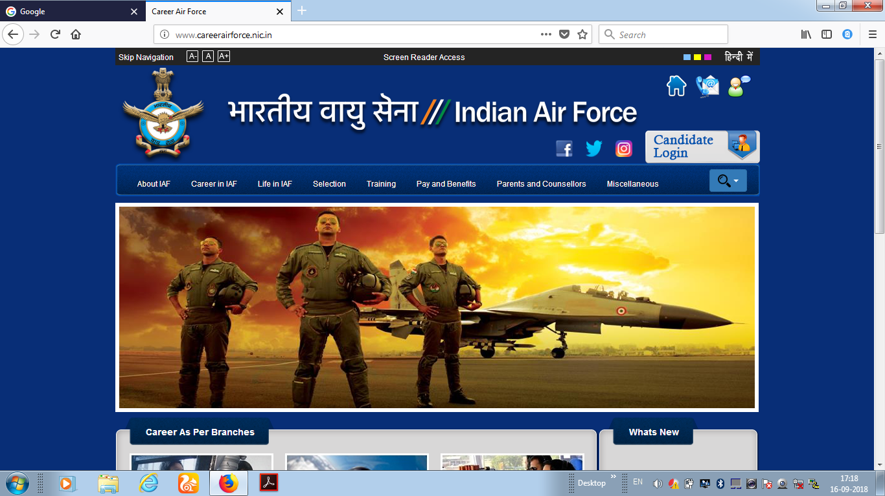

Slide 12
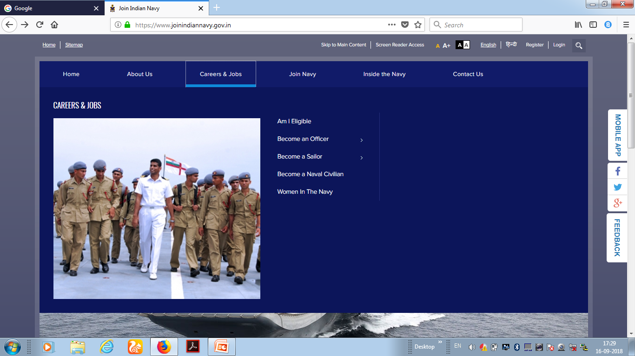

Slide 13
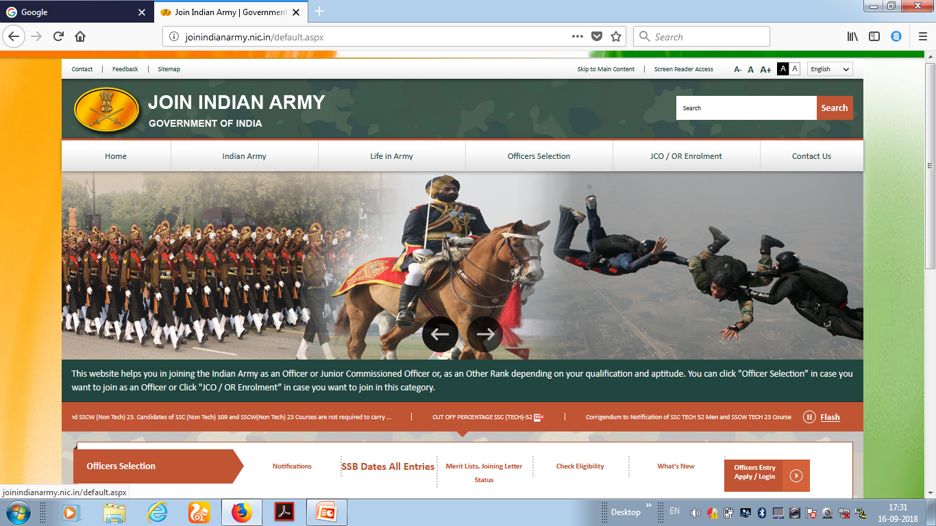

Slide 14
INDIAN COST GUARD www.indiancoastguard.nic.in
General Duty Commandants: B. Sc. (Phy & Maths) 60% ; 12th min 60% in Phy & Maths.
GD- Pilot/Navigator/Observer: B. Sc. (Phy & Maths) 60% ; 12th min 60% in Phy & Maths.
GD ( Women): B. Sc. (Phy & Maths) 60% ; 12th min 60% in Phy & Maths. ( Short Service Commission)
Short Service Commission: 8-10 Years: Pilots (Helicopter and Fixed Choppers): 12th min 60% in Phy & Maths. Valid Commercial pilot License, approved by DGCA.
Selection: Application Online, Entrance Exam.
Height: 157 cm (M); 152 cm (W)
SSC-CPC (M/F): 162.5 cm min – 197 cm Max, Leg length- 99cm.
Weight: Proportionate to height and Age +/- 10%
Chest: Well Proportionate min. Exp. 5 cm.
Eye Sight: 6/6; 6/9 with glasses; 6/9 correctable to 6/6 without glasses.
Scale: Asst. Comdt. - 15600-39100 GP: 5400

Slide 15
Central Bureau of Investigation (CBI)
Post: Investigation Grade –II / Technician
Eligibility: B. Sc. with Physics, Mathematics or Computer Science
Selection : Written Test +PI

Slide 16
Indian Forest Service Examination (UPSC)
www.upsc.gov.in
Eligibility: B. Sc. – Physics, Chemistry, Botany, Geology, Agri. Forestry, etc
Age Limit: 21-30 for general + 3 years for SC, ST
Attempts: GC: Four; OBC: Seven; SC/ ST: No Limit.
Physical Standards:-

Slide 17
UNION PUBLIC SERVICE COMMISSION (UPSC)
Indian foreign Services – IFS
Indian Administrative Services – IAS
Indian Police Services - IPS
Indian Revenue Services – IRS
Group A and Group B Services in various Central and State Govt. Departments
http://www.upsc.gov.in

Slide 18
BARC, IGCAR
Indira Gandhi Centre for Atomic Research
www.igcar.gov.in www.barc.gov.in www.barconlineexam.in
Post: -Scientific Officer
1) Scientific Officer - C: M. Sc. Physics, Material Science, Nuclear Physics.
2) Scientific Officer - B: M. Sc. Physics, Chem., Biosciences, Geology, Geography.
3) Scientific Assistant -B: B. Sc. – Physics minimum 60% marks.
4) Tradesman, Laboratory: - SSC/ HSC – 50 % Marks PCMB

Slide 19
Higher Study - Master Degree from the Universities
Master Degree
M. Sc. Nuclear Physics
M.Sc. PHYSICS
M.Sc. (Chemistry)
M.Sc. (Botany)
M.Sc. (Zoology)
MCA (computer Applications)
M.Sc. (computer Science) from any University / institute

Slide 20
Interested in SPORTS
Netaji Subhas National Institute of Sports, Patiala. www.nsnis.org
Lakshmibai National Institute of Physical Education (LNIPE), Gwalior. www.lnipe.gov.in

Slide 21
Two year MBA Programme
( Accelerated, Part-time, Executive, Distance, Dual)
El: Any Degree with 50% marks
Ad: Entrance Exam + GD + PI
Common Entrance Test- CAT
AIMS Test for Management Admission- ATMA
Commonwealth Executive Management Admission Test- CEMAT
Electronic management Admission Test – E-MAT
Graduate Management Admission Test – GMAT
Management Aptitude Test- MAT
Xaviers Admission Test – XAT
State Level Common Entrance Test
Admission Tests by Individual Institutes

Slide 22
FORENSIC SCIENCE (FORENSICS)
El: B. Sc. with Physics, Chem., Zoo, Botany, Biochem, Micro, B. Pharma, BDS, Applied Science.
Ad: Written Test and Interview
Inst:
1. Punjabi University, Chandigarh.
2. University of Delhi, Delhi.
3. Gujarat University, Ahmadabad.
4. Institute of Forensic Science and Criminology,
Budhelkand Uni., MP
5. Osmania University, Hyderabad.
6. Faculty of Law, University of Pune, Pune.

Slide 23
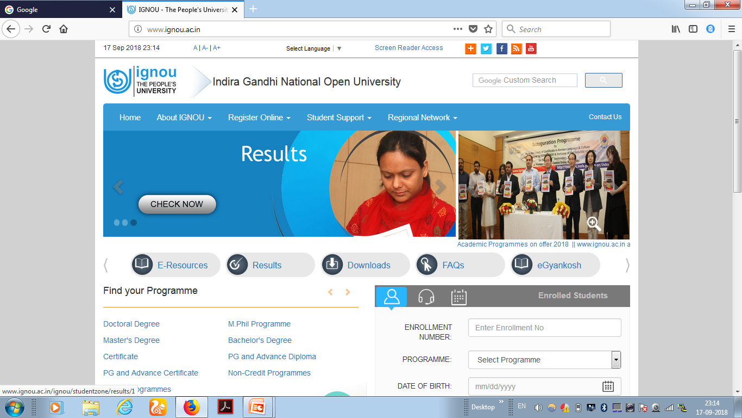
Notes:
Open university (distance education) website address www.ignou.ac.in

Slide 24
Distance Education
Learning without Borders
Indira Gandhi National Open University (IGNOU), New Delhi.
ICDEOL.
State Open Universities.
Distance Programmes by Regular Universities.
Approved by Distance Education Council

Slide 25
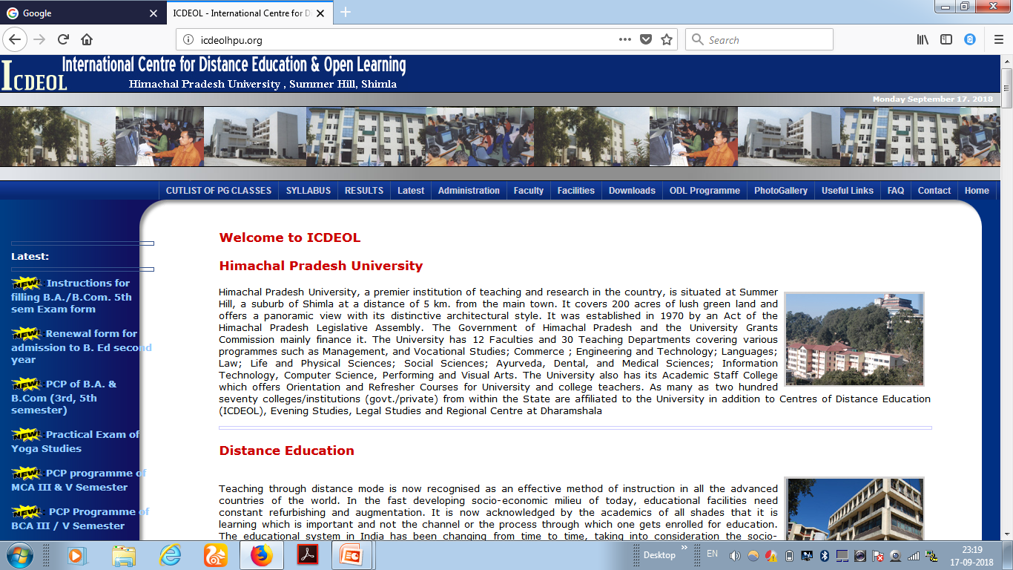
Himachal Pradesh University

Slide 26
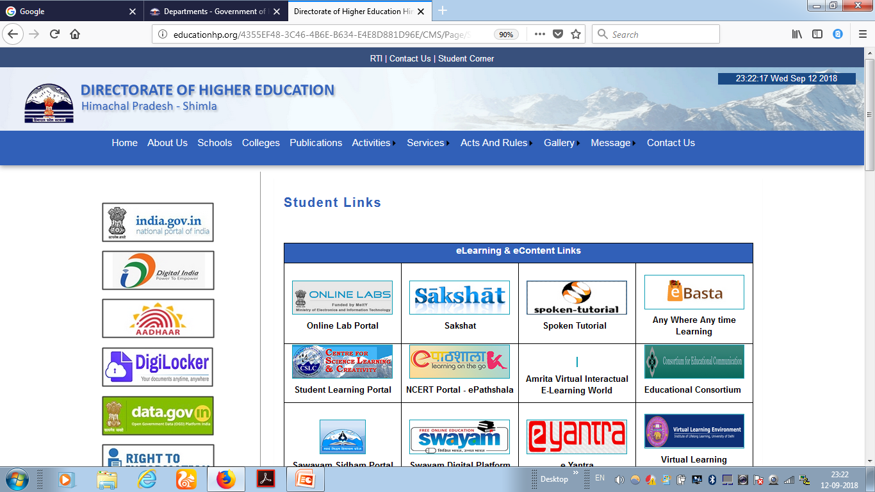

Slide 27
THANKS
Namaskar
Jai Hind !

